Slide 1
组会汇报
汇报人：王子晨

Slide 2
文献
Focal-SAM: Focal Sharpness-Aware Minimization for Long-Tailed Classification
Sicong Li 1 2 Qianqian Xu 3 Zhiyong Yang 4 Zitai Wang 3
Linchao Zhang 5 Xiaochun Cao 6 Qingming Huang 4 7 3

Slide 3
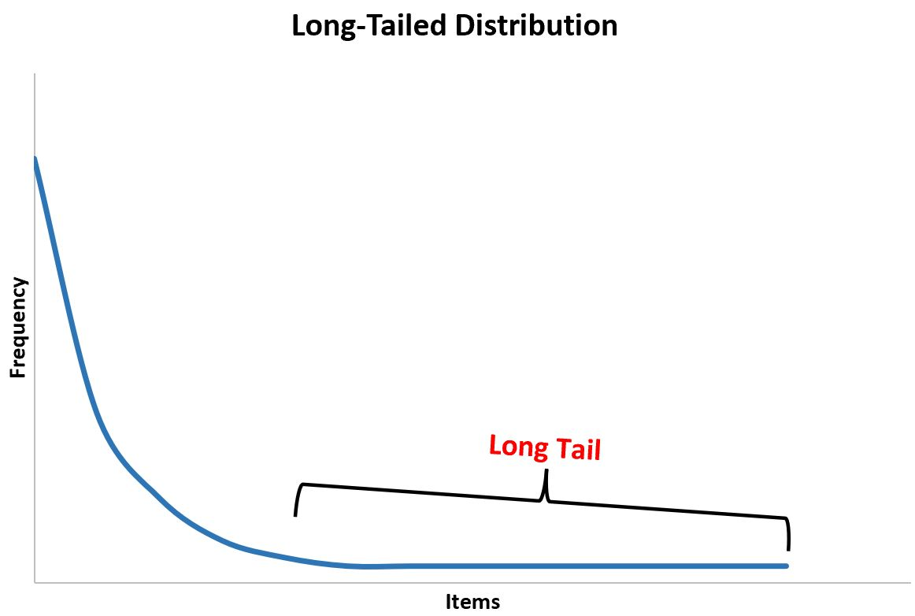
Long-Tailed Distribution

Slide 4
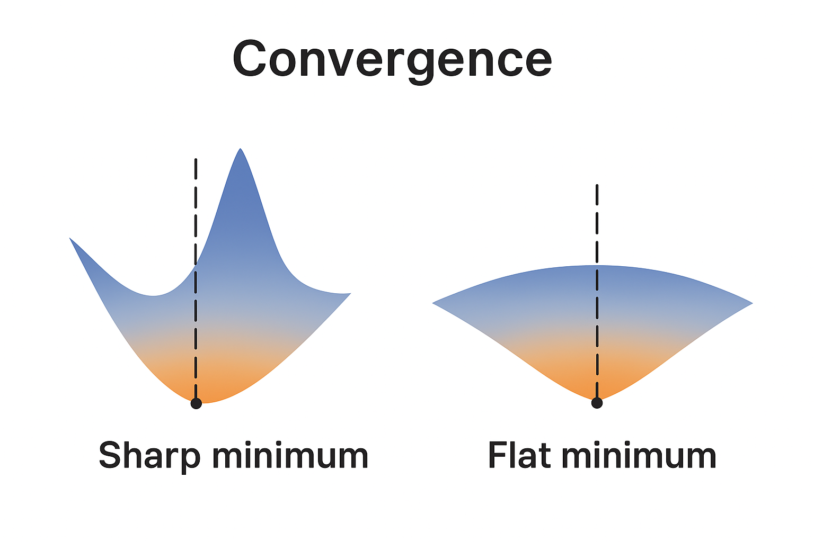

Slide 5
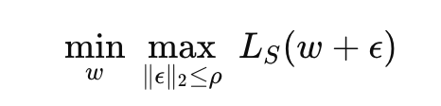
Sharpness-Aware Minimization (SAM)

Slide 6
Recent Methods
1. ImbSAM
2. CC-SAM

Slide 7
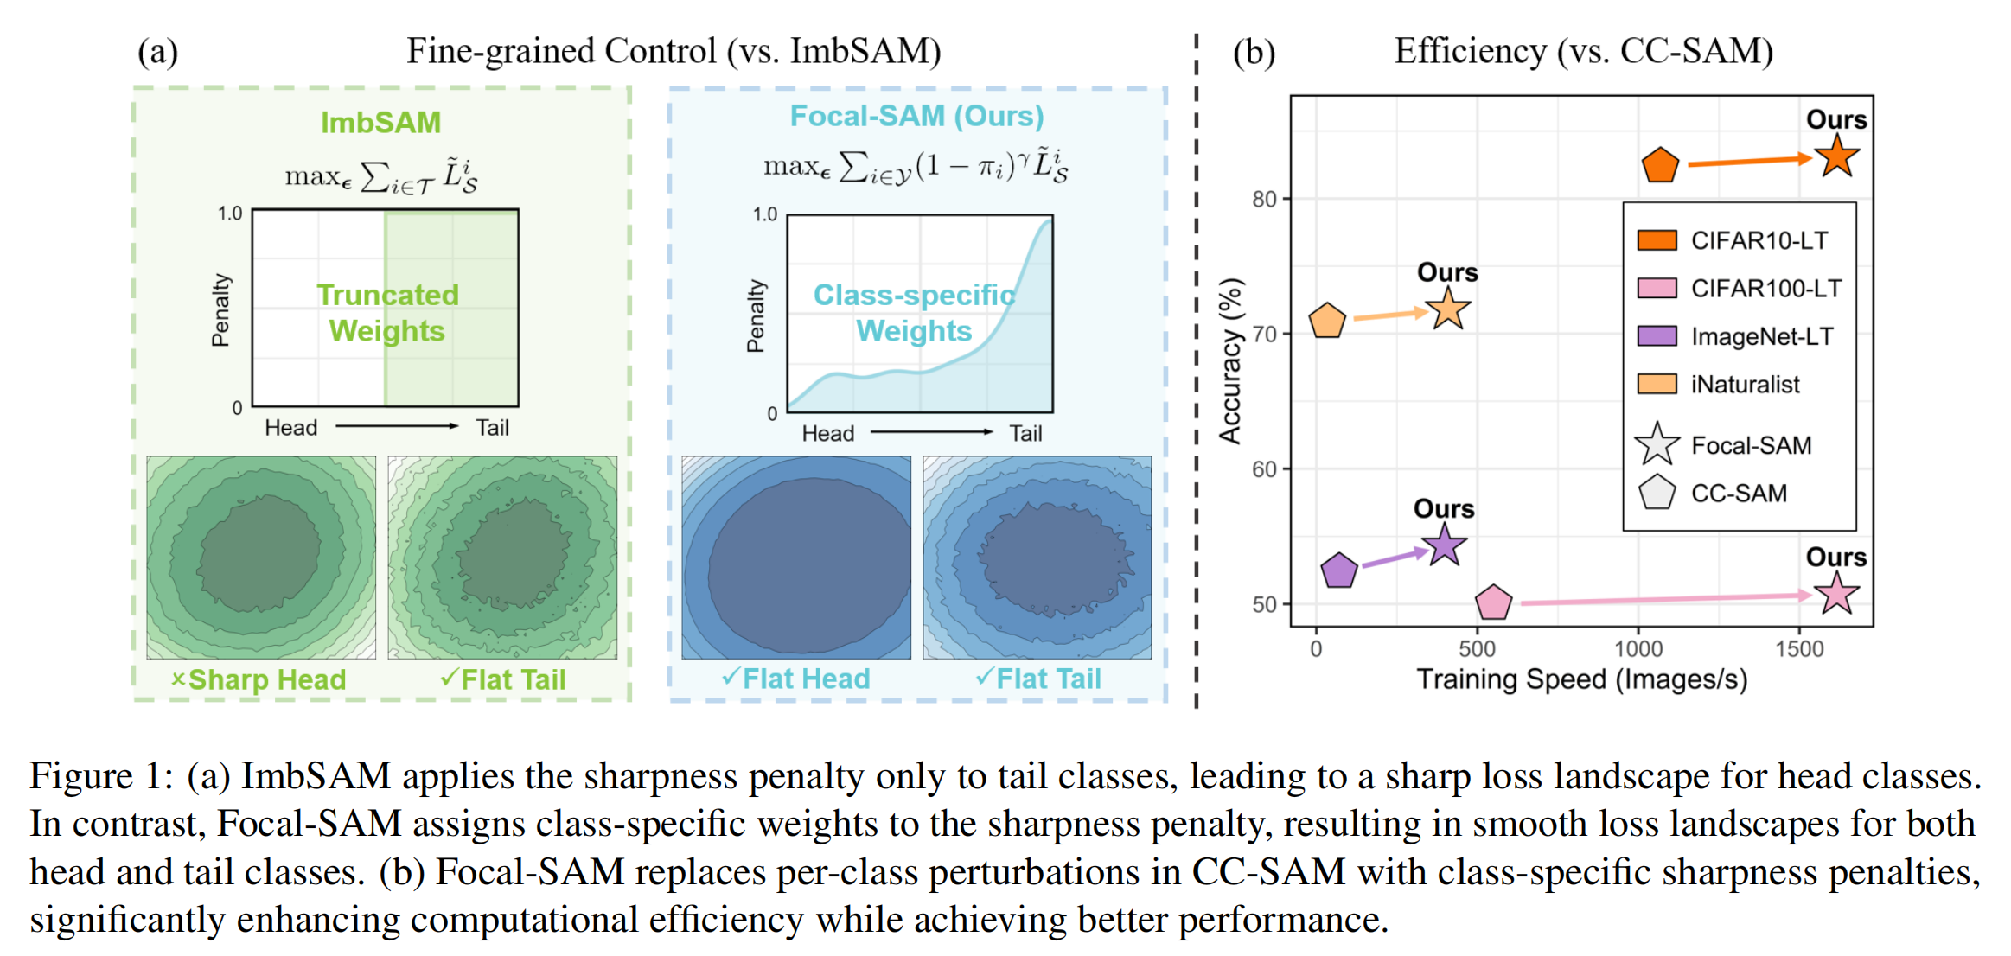
Focal-SAM

Slide 8
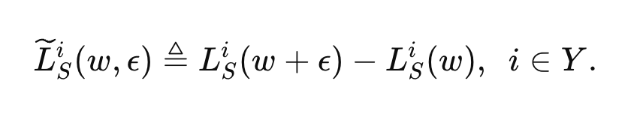
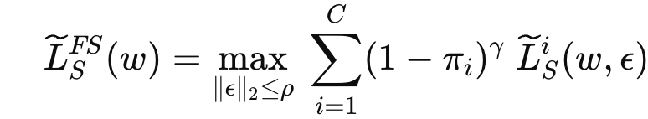
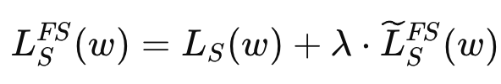
Method
class-wise sharpness
（1）
focal sharpness
（2）
objective function
（3）

Slide 9
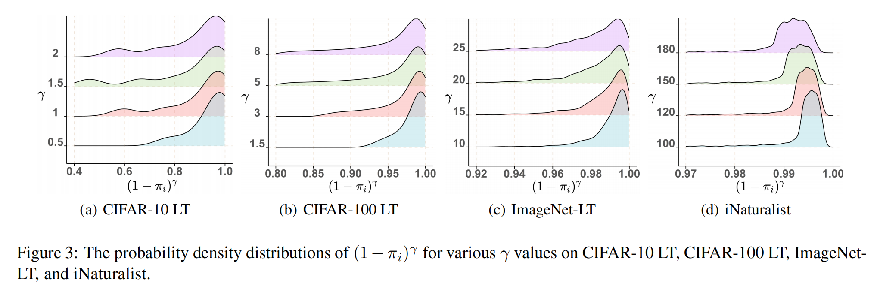

Slide 10
Thoughts

Slide 11
Thanks

